Slide 1
Classifiers

Slide 2
Outline
Train set and validation set
Support vector machine
Hyperparameter tuning
Transformer introduction

Slide 3
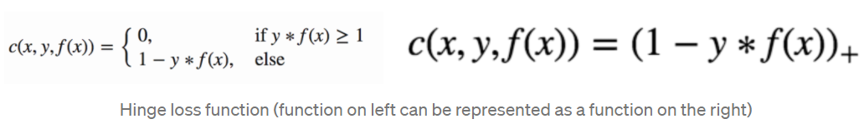
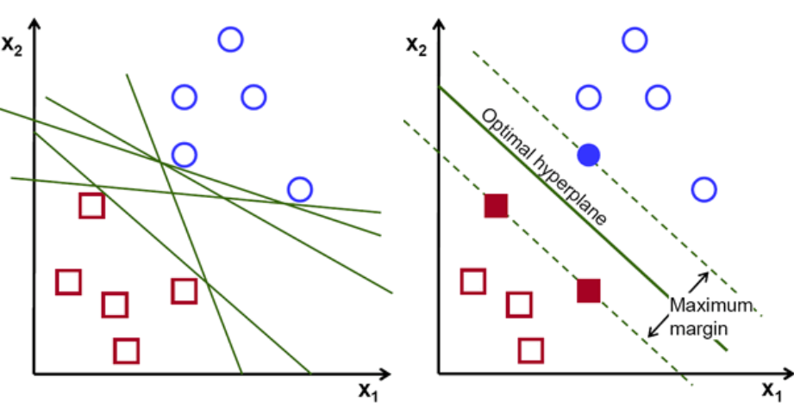
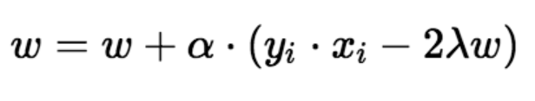
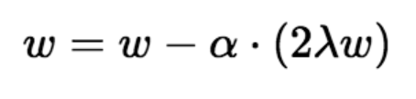
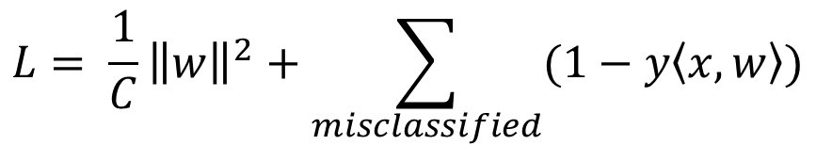

Support vector machine
Two hyperparameters:
C: regularization
tol: when the update is less then tolerance, stop training.
$$L= \frac{1}{C}{\left\|w\right\|}^{2}+\sum_{misclassified}{(1−y\left\langle x,w\right\rangle )}$$
Use gradient descent to solve the problem:
When there is misclassification:
$$\frac{2}{\left\|w\right\|}$$
When there is no misclassification:
https://towardsdatascience.com/support-vector-machine-introduction-to-machine-learning-algorithms-934a444fca47
https://stats.stackexchange.com/questions/255375/what-exactly-is-tol-tolerance-used-as-stopping-criteria-in-sklearn-models

Slide 4
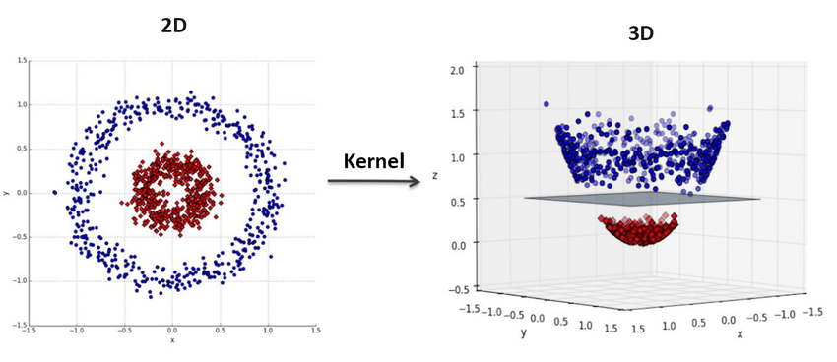
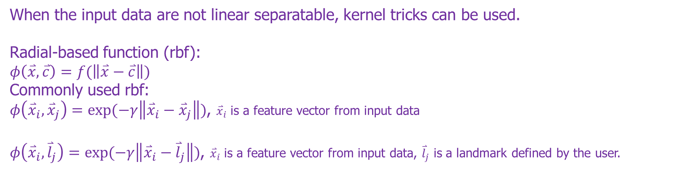
Kernel trick
When the input data are not linear separatable, kernel tricks can be used.
Radial-based function (rbf):
$$φ\left(\overset{⃑}{x},\overset{⃑}{c}\right)=f(\left\|\overset{⃑}{x}−\overset{⃑}{c}\right\|)$$
Commonly used rbf:
$φ\left({\overset{⃑}{x}}_{i},{\overset{⃑}{x}}_{j}\right)=exp⁡(−γ\left\|{\overset{⃑}{x}}_{i}−{\overset{⃑}{x}}_{j}\right\|)$, ${\overset{⃑}{x}}_{i}$ is a feature vector from input data
$φ\left({\overset{⃑}{x}}_{i},{\overset{⃑}{l}}_{j}\right)=exp⁡(−γ\left\|{\overset{⃑}{x}}_{i}−{\overset{⃑}{l}}_{j}\right\|)$, ${\overset{⃑}{x}}_{i}$ is a feature vector from input data, ${\overset{⃑}{l}}_{j}$ is a landmark defined by the user.
Gamma: radius of the rbf
Use (0,0) as the landmark.

Slide 5
Train set and validation set
Original dataset
Shuffled dataset
Random shuffle
Divide
Train set 1
Validation set 1
2
3
4
5
6
7
8
1
Divided into 8 folds
Train set 2
Validation set 2
1
3
4
5
6
7
8
2
1
2
3
4
5
6
7
8
Train set 8
Validation set 8
1
2
3
4
5
6
7
8

Slide 6
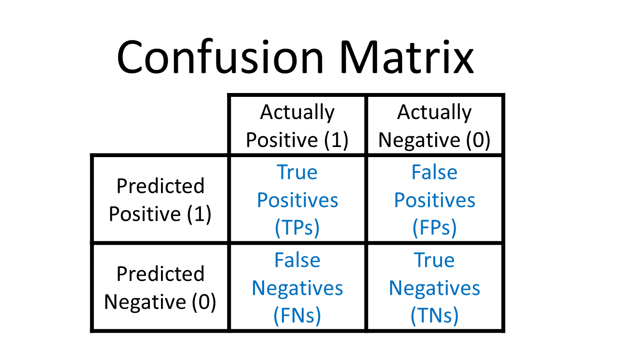
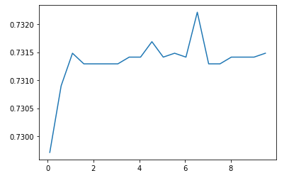
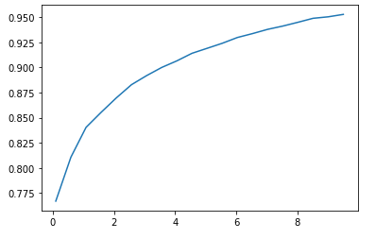



Cross-validation result
https://towardsdatascience.com/accuracy-precision-recall-or-f1-331fb37c5cb9
$$Precision= \frac{TP}{TP+FP}$$
$$Recall= \frac{TP}{P}=\frac{TP}{TP+FN}$$
$$F1=2∗\frac{Precision∗Recall}{Precision+Recall}$$
Linear kernel with different regularization coefficient
RBF kernel with different regularization coefficient

Slide 7
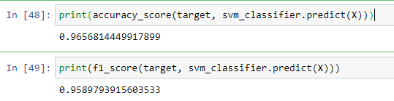
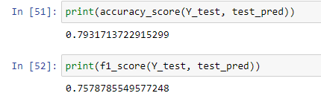
Test result
Choose hyperparameters:
Kernel: rbf
C: 10
On the train set:
On the pre-test set:

Slide 8
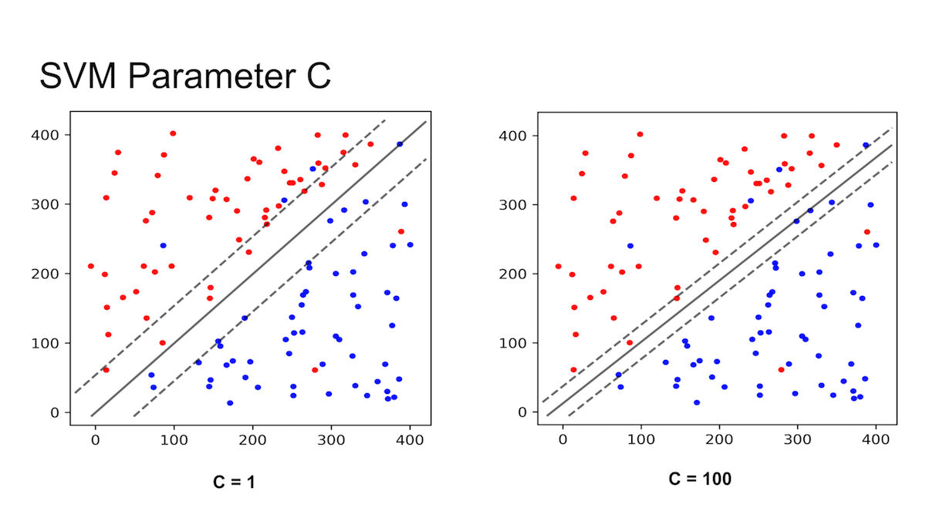
Overfitting

Slide 9
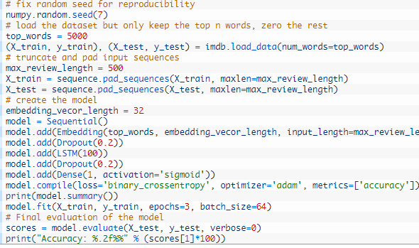
Long short-term memory
Dataset preparation
Model setup
Model training
Model evaluation
LSTM example:
https://www.analyticsvidhya.com/blog/2021/06/lstm-for-text-classification/
Tensorflow API documentation for LSTM:
https://www.tensorflow.org/api_docs/python/tf/keras/layers/LSTM
Youtube video explaining how LSTM works:
https://www.youtube.com/watch?v=5dMXyiWddYs
Another LSTM example:
https://machinelearningmastery.com/sequence-classification-lstm-recurrent-neural-networks-python-keras/

Slide 10
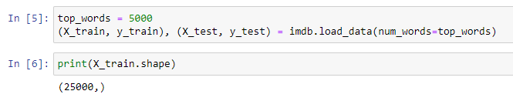
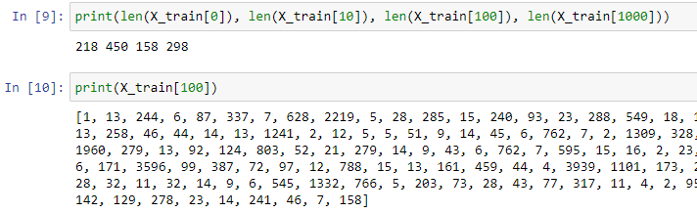
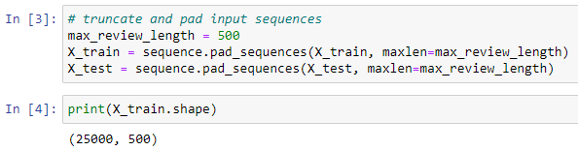
Dataset preparation for LSTM
Load the data.
Total number of samples: 25000
Each sample is a list of indices representing words (in a dictionary).
The indices start from 1 not 0, because 0 is used for padding.
Padding the data so everyone has 500 words.

Slide 11
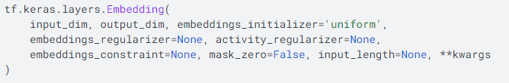
Embedding layer
Instead of using hand-engineered features or pretrained models to embed a word in a vector space, embedding can be embedded in the model to be trained. So, the actual embedding mapping is learned from the training data.
An embedding layer accepts a list of indices (words) rather than a list of one-hot encoded vectors.
The list has a fixed length.

Slide 12
Next step
Task 1: fine-tune the hyperparameters for SVM, decision tree, kernel ridge, and random forest. Find an upper limit of these “traditional” models.
Task 2: Test LSTM and transformer. Get familiar with the deep models.

